Slide 1
How Computers Store Variables

Slide 2
How Computers Store Variables
Suppose we type the following commands in MATLAB:
EDU>> y = 42;
EDU>> FavoriteDay = ‘Friday’
We know MATLAB stores the values associated with the variables, y and FavoriteDay, in memory.
How are these values stored?

Slide 3
How Computers Store Variables
Computers store all data (numbers, letters, instructions, …) as strings of 1s and 0s (bits).
A bit is short for binary digit. It has only two possible
values: On (1) or Off (0).

Slide 4
Terminology
A bit is short for binary digit. It has only two possible
values: On (1) or Off (0).
A byte is simply a string of 8 bits.
A kilobyte (kB) is 1000 bytes
A megabyte (MB) is 1,000,000 bytes
A gigabyte (GB) is 1,000,000,000 bytes
For a sense of size, click on link below:
http://highscalability.com/blog/2012/9/11/how-big-is-a-petabyte-exabyte-zettabyte-or-a-yottabyte.html

Slide 5
Numeric Data Types
MATLAB has several different options for storing numbers as bits. Unless you specify otherwise, all numbers in MATLAB are stored as doubles.
Name | Description | Range
double | 64 bit floating point | -1.79769313486232E308 to -4.94065645841247E-324 4.94065645841247E-324 to 1.79769313486232E308
single | 32 bit floating point | −3.402823E38 to −1.401298E-45 1.401298E-45 to 3.402823E38
uint8 | 8 bit unsigned integer | Integers from 0 to 255
int8 | 8 bit signed integer | Integers from −128 to 127
uint16 | 16 bit unsigned integer | Integers from 0 to 65535
int16 | 16 bit signed integer | Integers from −32768 to 32767
uint32 | 32 bit unsigned integer | Integers from 0 to 4294967295
int32 | 32 bit signed integer | Integers from −2147483648 to 2147483647

Slide 6
Data Types: int8, uint8, int16, uint16, int32, uint32
These data types work for integers as long as the integers don’t exceed the range for the data type chosen.
They take up less memory space than doubles.
They don’t work for non-integers. If you create a variable that is an int8 and try to assign it a value of 14.8, that variable will be assigned a value of 15 instead (closest integer within the range).
One common application for integer data types is image data (jpeg, png, …)

Slide 7
Data Types: double and single
A double uses 64 bits to store a number.
A single uses 32 bits to store a number.
Doubles and singles can be used to represent both integers and non-integers.

Slide 8
Why should I care how data is stored in a computer?
Example: Perform each of the following calculations in
your head.
a = 4/3
b = a – 1
c = 3*b
e = 1 – c
What does MATLAB get?

Slide 9

Why should I care how data is stored in a computer?
What does MATLAB get?
a = 4/3 = 1.3333
b = a – 1 = 0.3333
c = 3*b = 1.0000
e = 1 – c = 2.2204e-016
It is not possible to perfectly represent all real
numbers using a finite string of 1s and 0s.

Slide 10
Comments
Not all numbers can be represented exactly even using 64 bit doubles. If we do many, many calculations with numbers which are just a tiny bit off, that error can grow very, very large depending on the type of computations being performed.
64 bit doubles have a huge, but still limited range. What happens if we exceed it? Try the following:
EDU>> a = 373^1500
EDU>> b = factorial(172)

Slide 11
ASCII Code
When you press a key on your computer keyboard, the key that you press is translated to a binary code.
A = 1000001 (Decimal = 65)
a = 1100001 (Decimal = 97)
0 = 0110000 (Decimal = 48)

Slide 12
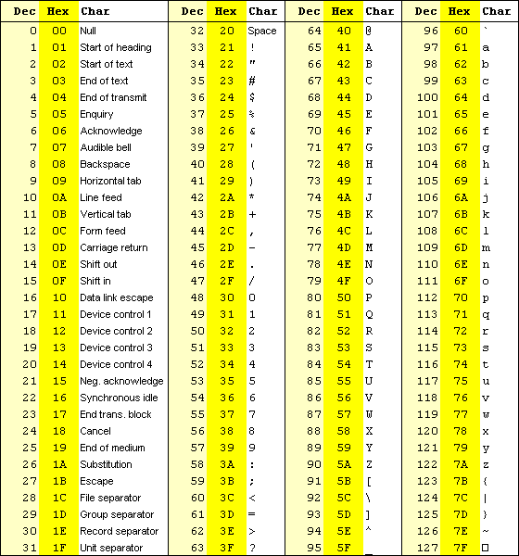
ASCII Code

Slide 13
Strings in MATLAB
MATLAB stores strings as an array of characters using the ASCII code.
Each letter in a string takes up two bytes (16 bits) and the two bytes are the binary representation of the decimal number listed in the ASCII table.
Try the following in MATLAB:
EDU>> month = ‘August’
EDU>> double(month)

